Slide 1

Kaptcha
Made by Marin Nikolic, Nikola Igic and Marko Radulovic
Professor: Dr. Sc. Martin Žagar Course: ISTE- 442 Secure Web App Development

Slide 2

Agenda
Team roles
Info
System architecture
Technologies
Extra

Slide 3
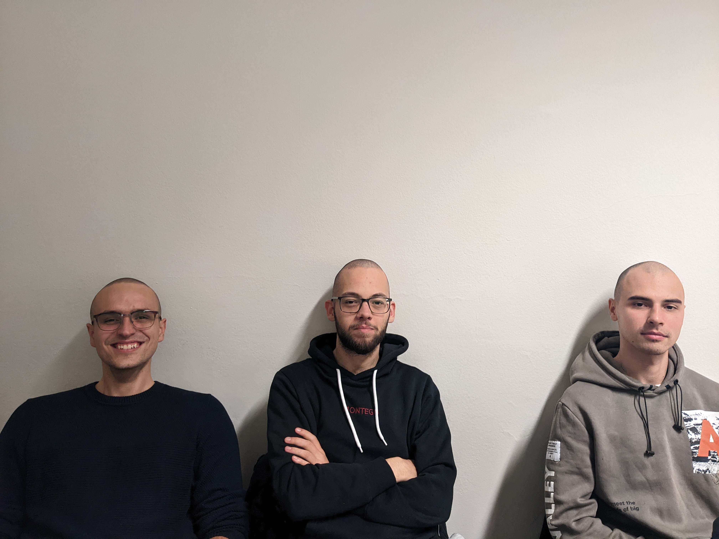
Team Roles
Marko Radulovic
Full stack
Marin Nikolic
Full stack
Nikola Igic
Full stack

Slide 4
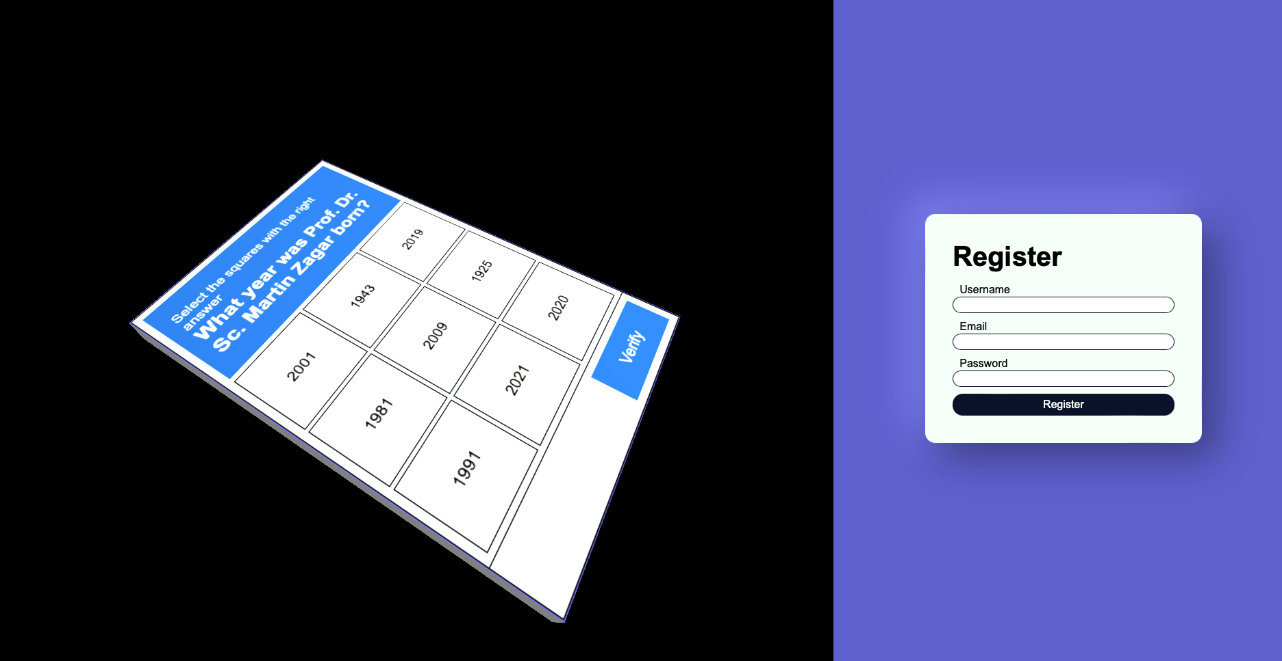

Slide 5
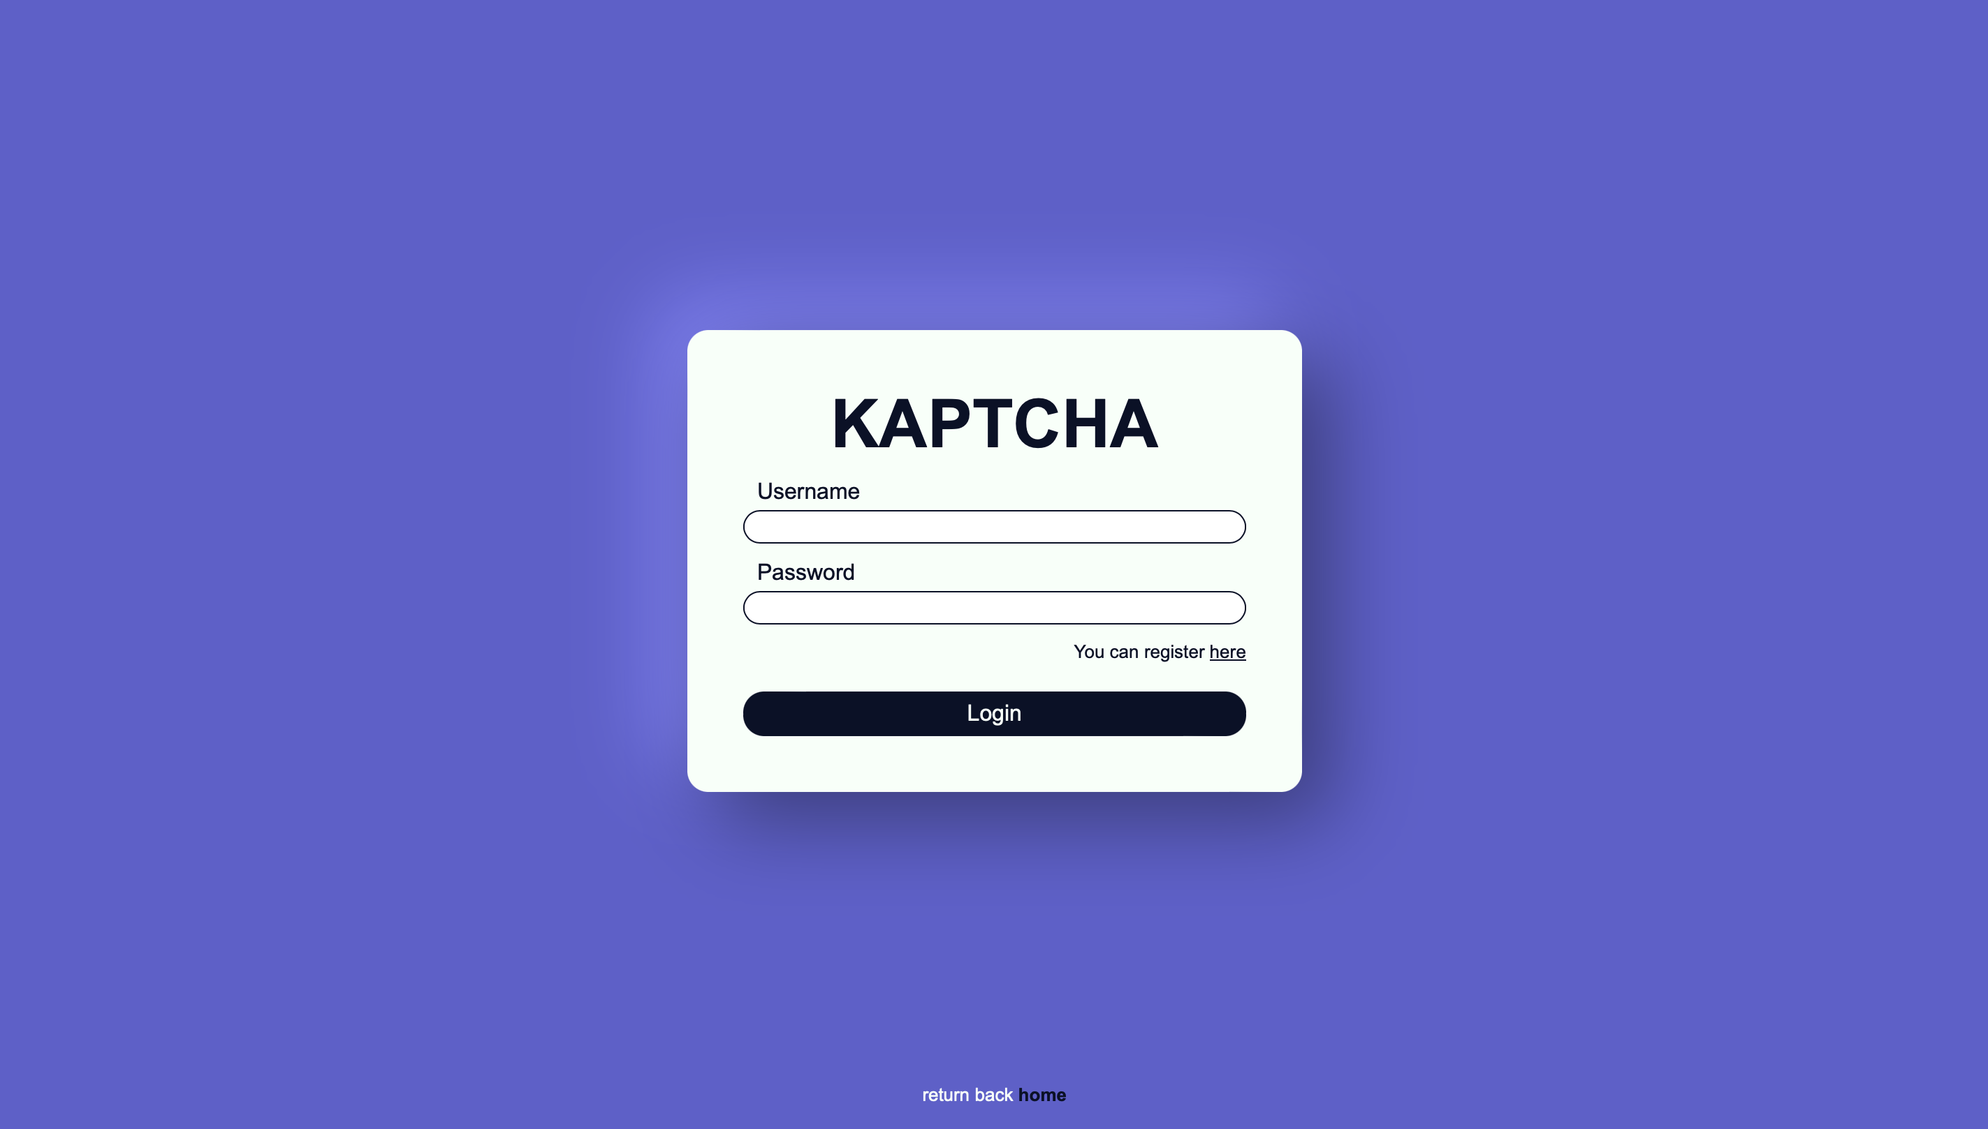

Slide 6
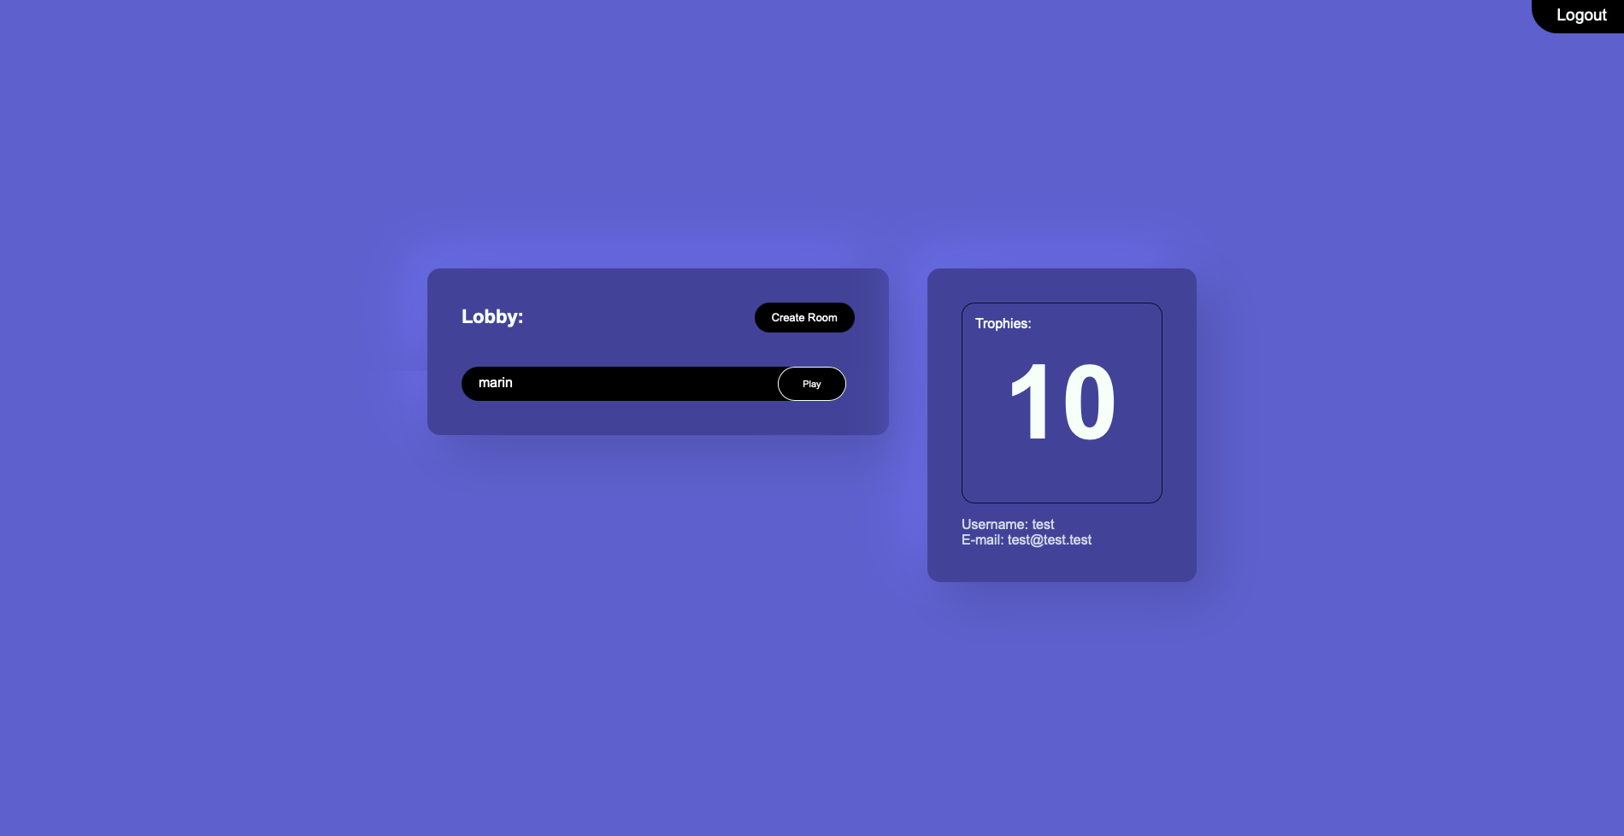

Slide 7
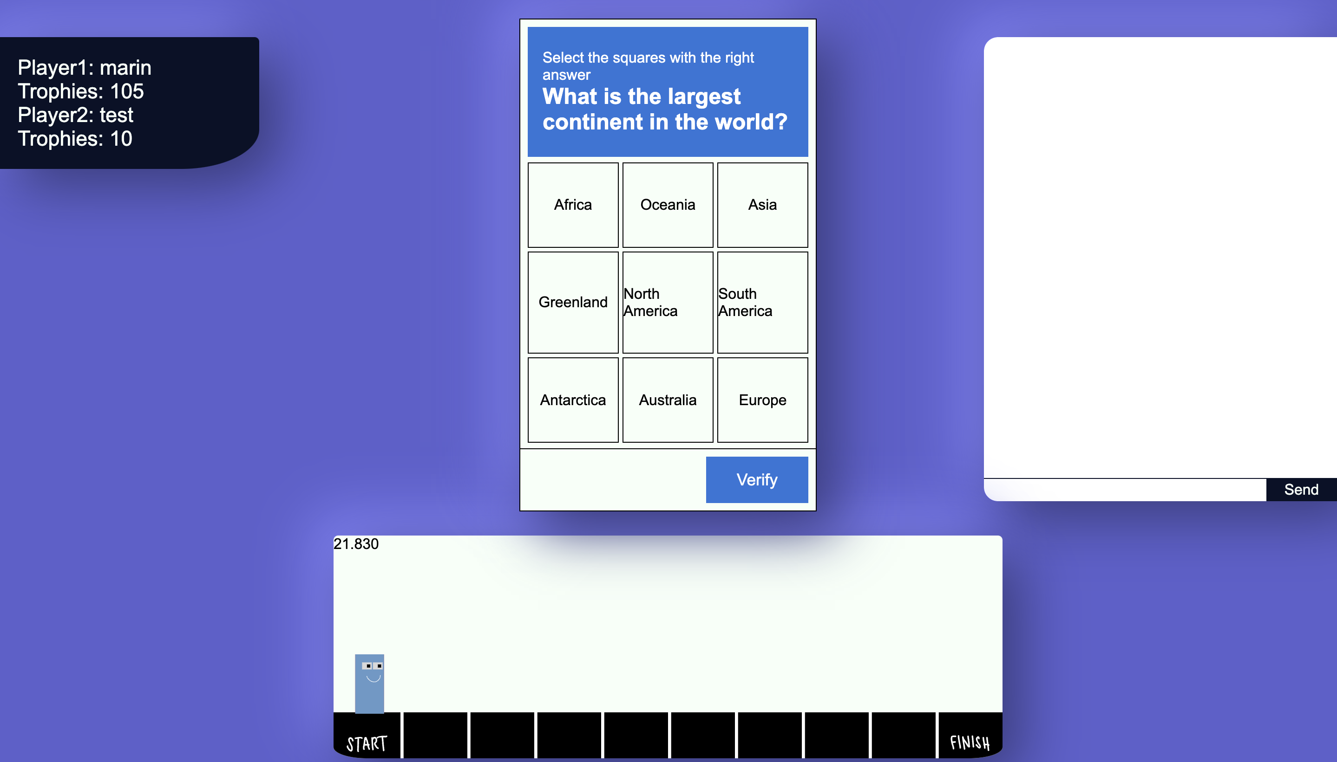
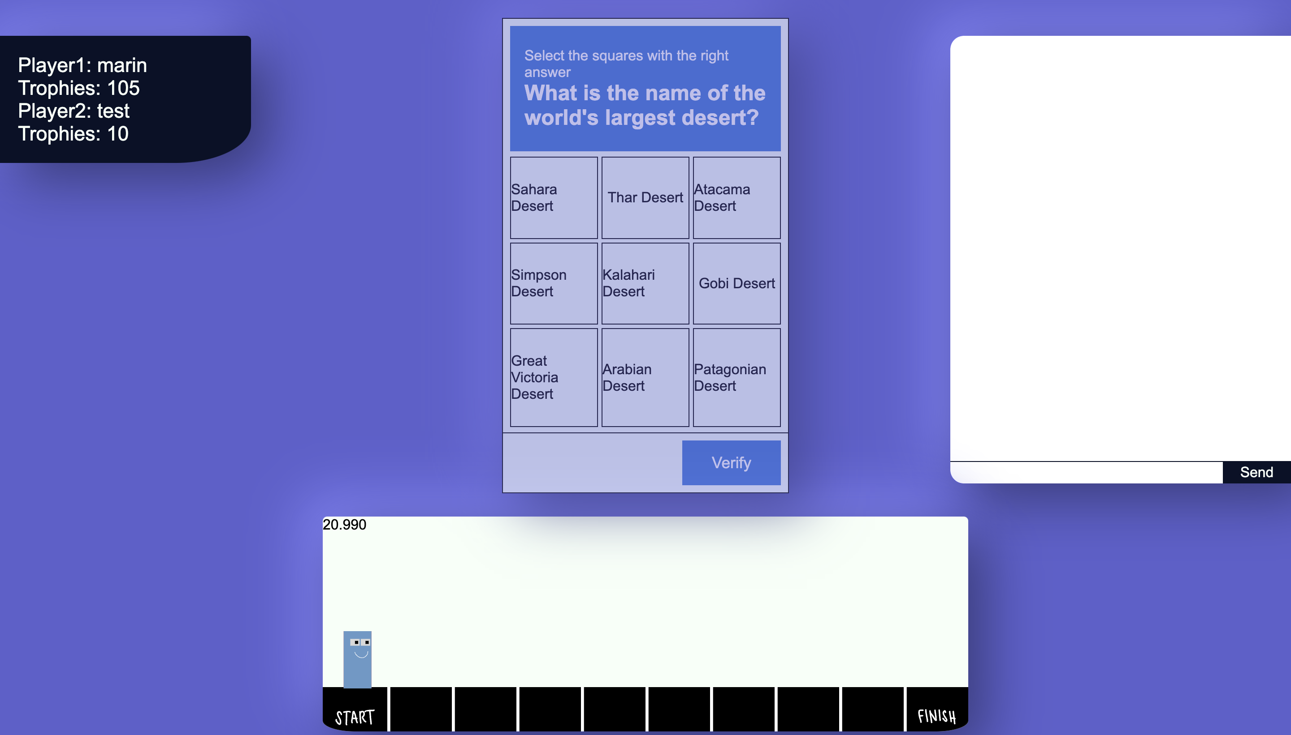

Slide 8
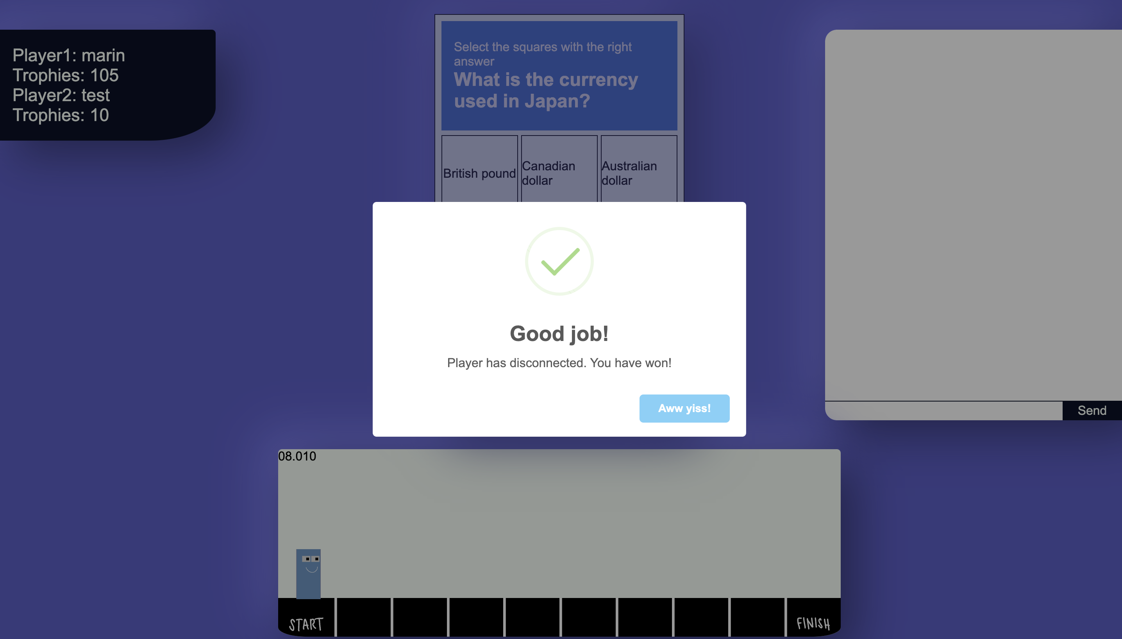
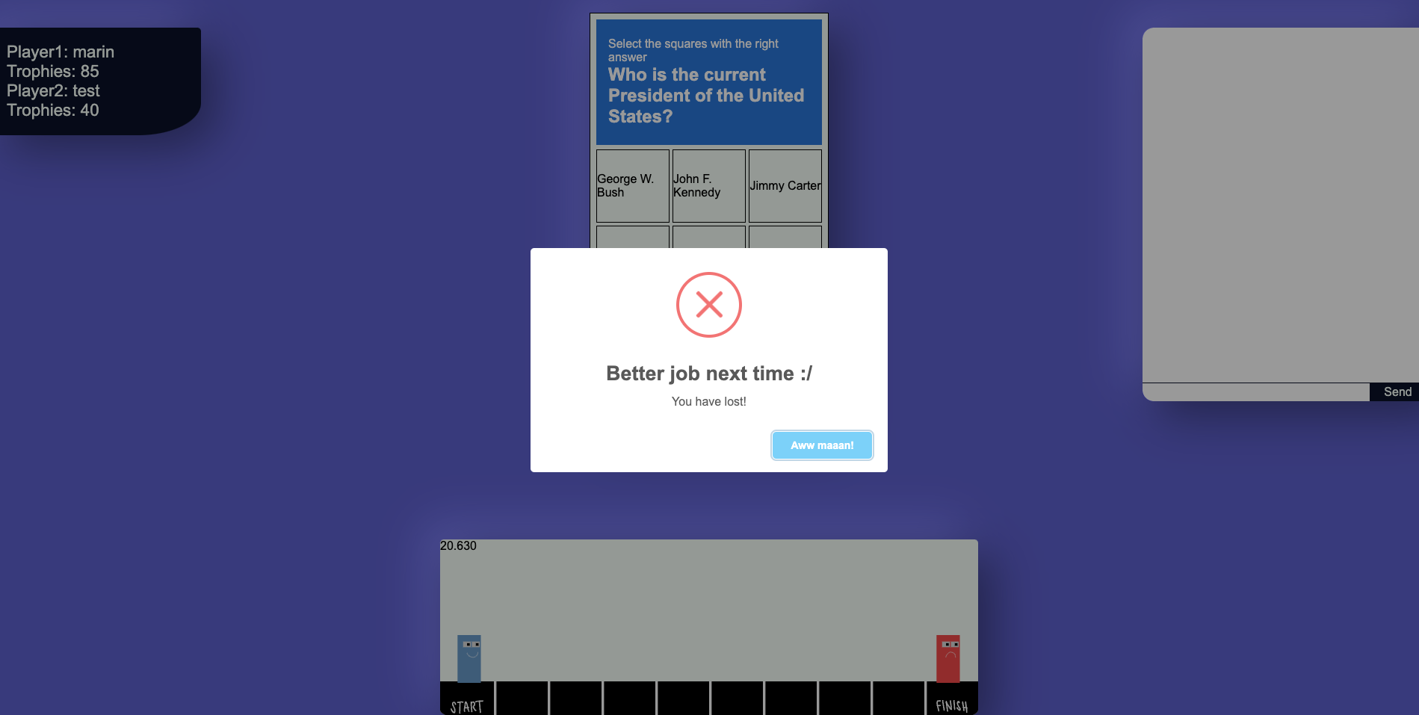

Slide 9
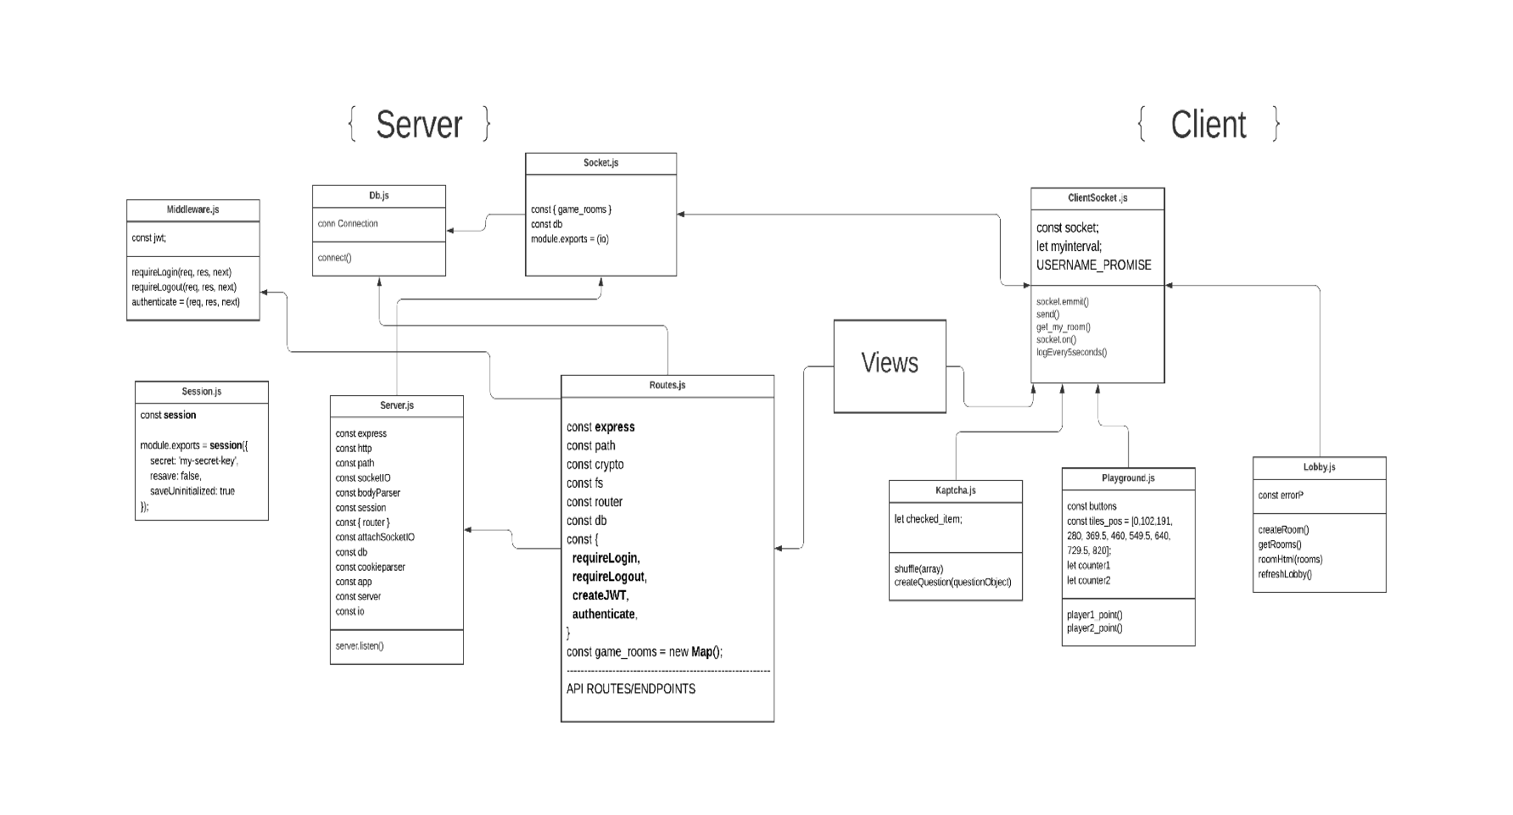

Slide 10
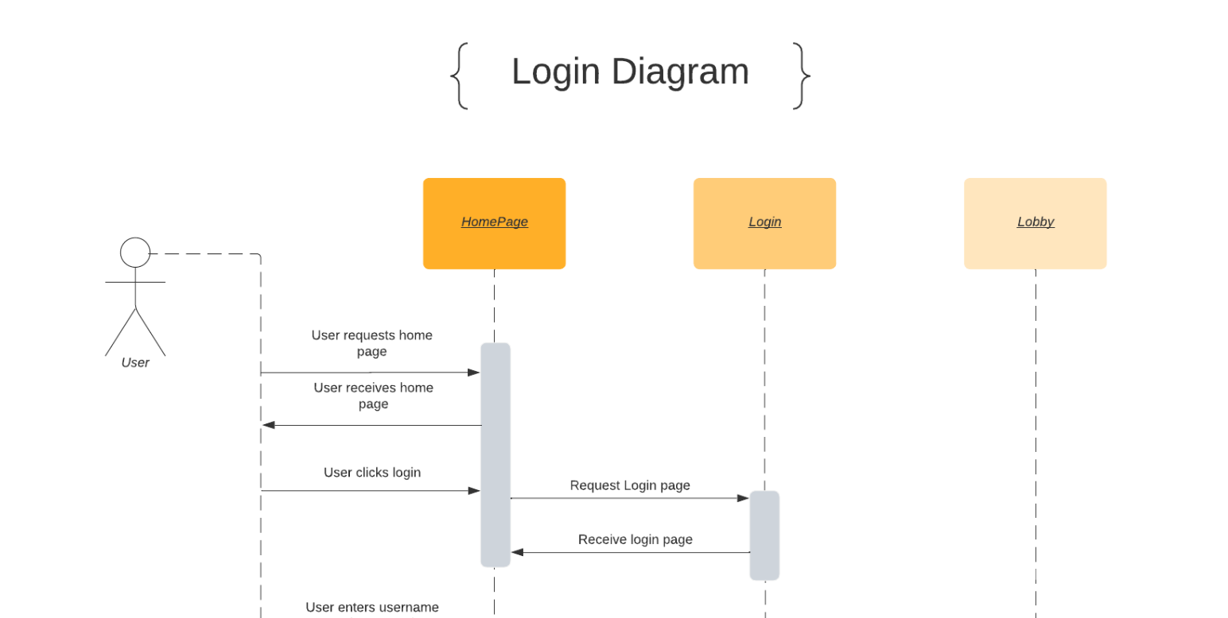

Slide 11
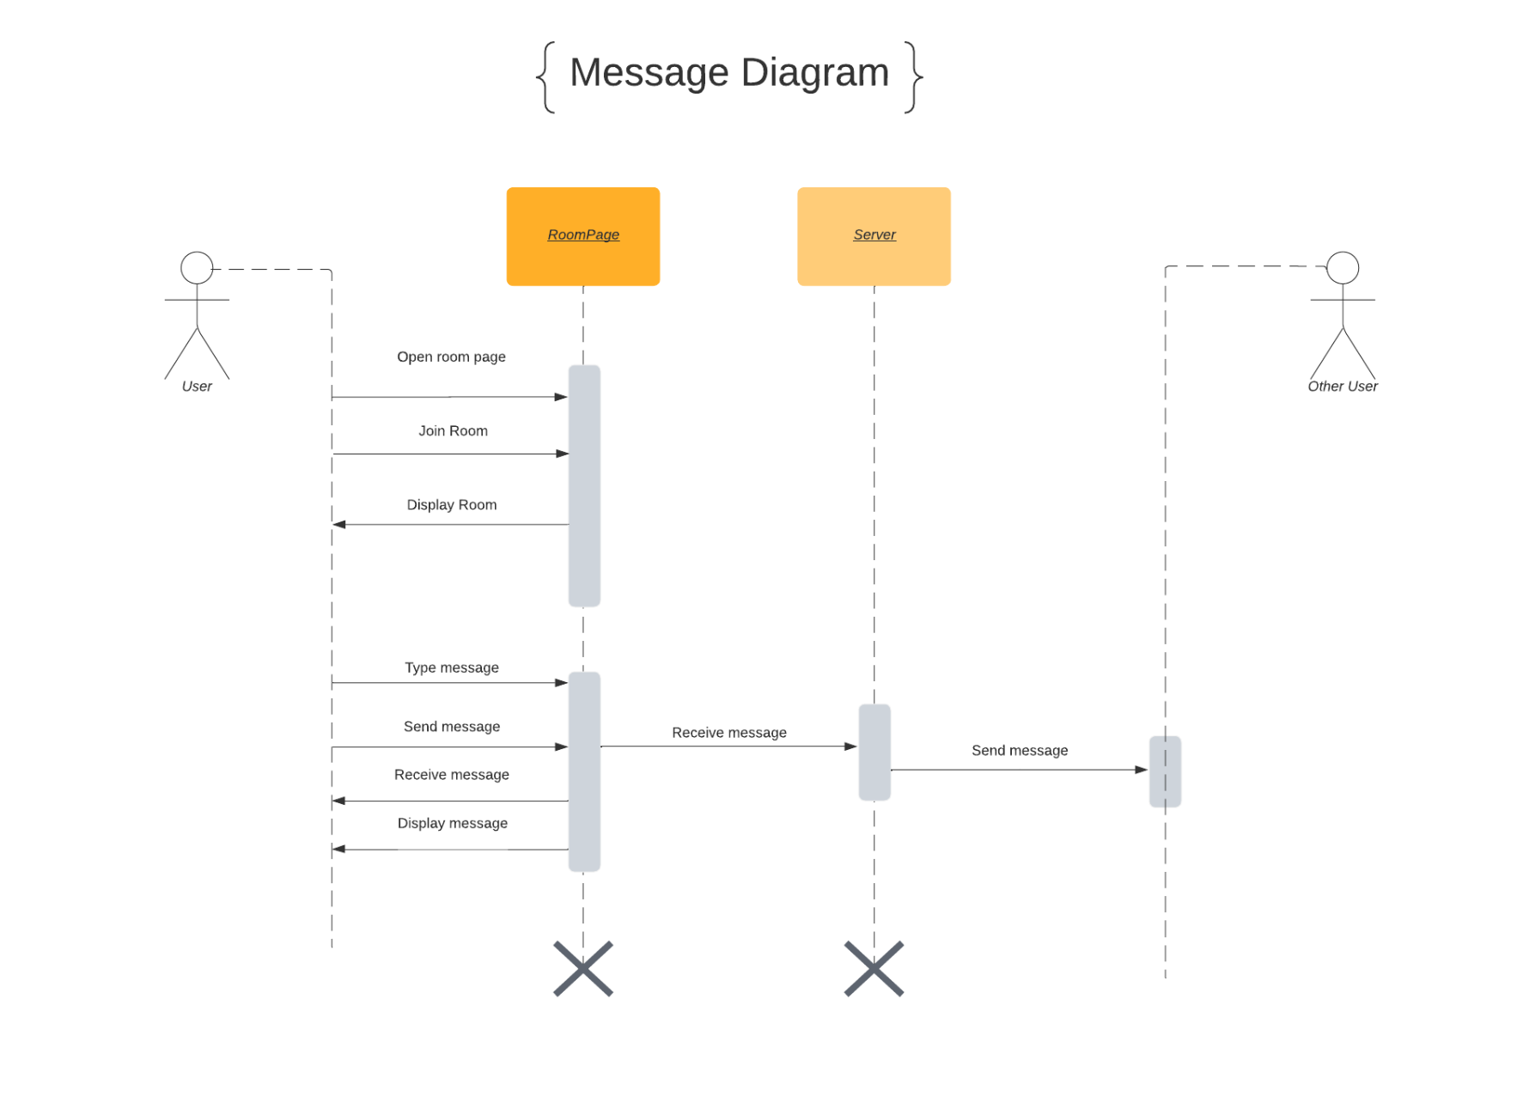

Slide 12
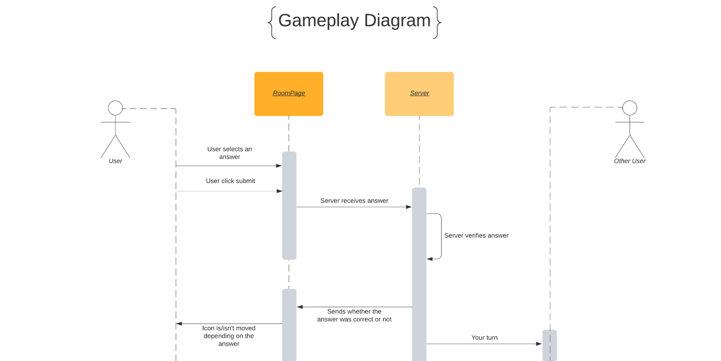

Slide 13



Technologies

Slide 14
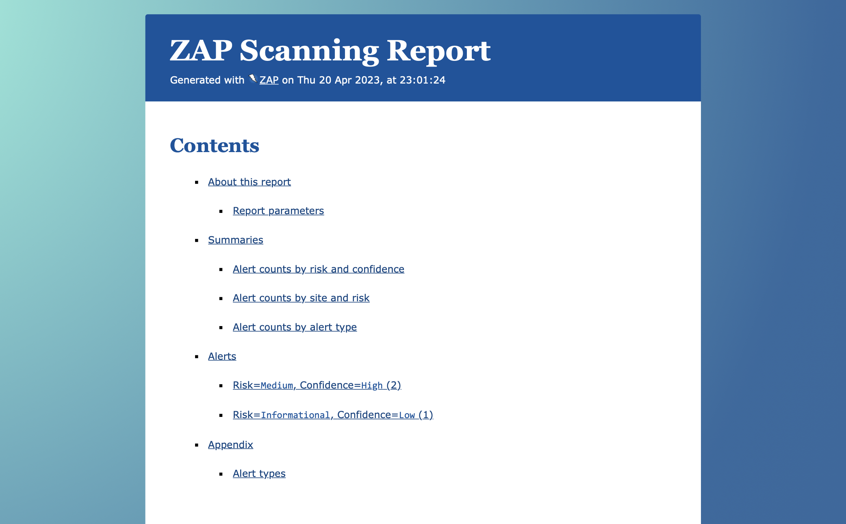
Zap

Slide 15
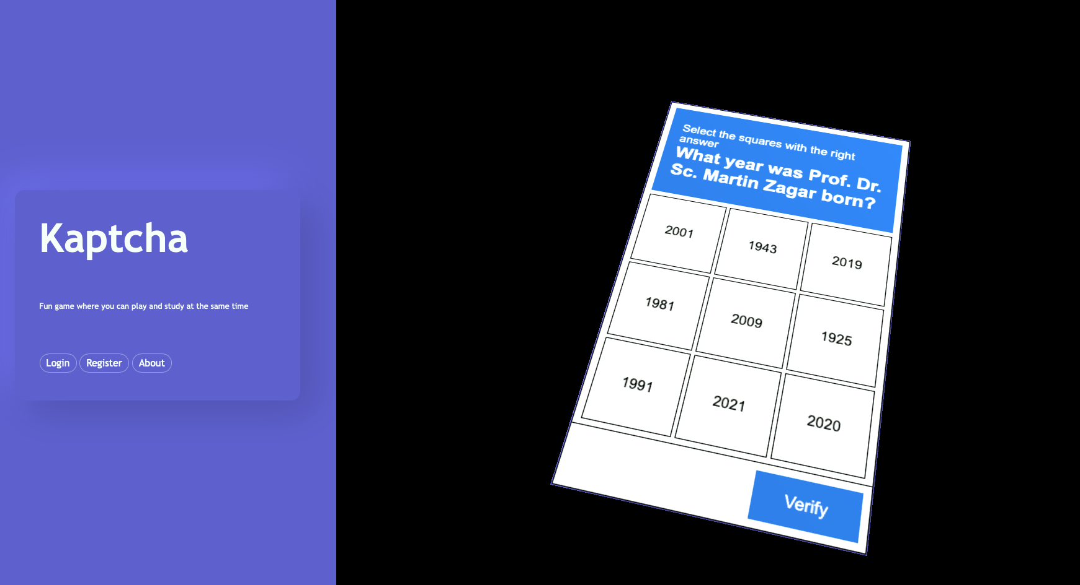
Extras

Slide 16


